Slide 1


Welcome
A friendly welcome from your health engagement coach, Leah
My role is to support your health and well-being.
Notes:
0

Slide 2




Wellness Programs & Resources
I can connect you with tools and programs that support your health goals. Whether you are interested in fitness, nutrition, stress management or preventative care.
UHC Rewards
Your health plan comes with a way to earn up to $300! Make sure you register on myuhc.com and select UHC Rewards to start earning your rewards.
Wellness Events & Committees
If your interested in getting involved, we have wellness committees and events throughout the year you can participate in or help shape.
Check out our Wellness Website

Slide 3
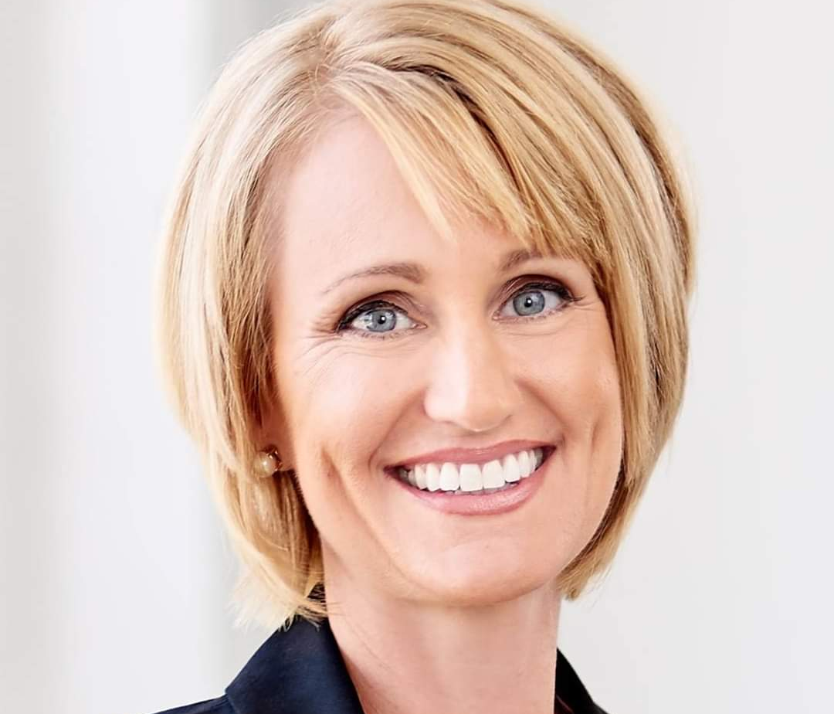
Get in touch with Leah
Please let me know if you have any questions, as well as if I can do anything to support your health & well-being.
Be well,
Leah Hammel
Mobile: 314.439.6846
Leah_hammel@uhc.com

